Slide 1

C Programming Project Presentation
Project Title: UNIT CONVERTER SUITE
Course: C Programming Lab / Mini Project
Student Name & Roll No: ANJALI V (25BCS206)
ASWIN KUMAR K (25BCS207)
BALA MURALI KRISHNA G (25BCS208)
BALASARAVANAN A (25BCS209)
BAVATHARANI A (25BCS210)
Department: Computer Science I ‘C’
Mentor / Guide: Mrs SELVI/MR MOSSES JOHN PRAKASH

Slide 2
Introduction
C Programming Project Presentation
The Unit Converter Suite is a command-line based C program designed to convert values across various measurement units. It supports conversions for length, weight, temperature, volume, and time. The system provides accurate, fast, and user-friendly conversions for educational and practical use.

Slide 3
Objective
C Programming Project Presentation
Main goals of the project:
• To design and implement a C-based program to automate tasks
• To apply core programming logic and modular design
• To demonstrate problem-solving and analytical skills

Slide 4
Problem Statement
C Programming Project Presentation
Manual conversions are error-prone and time-consuming. Existing tools lack offline support and customization. Our system offers a lightweight, offline solution with multiple unit categories and precise calculations.

Slide 5
System Requirements
C Programming Project Presentation
Hardware Requirements:
• Processor: Intel i3 or higher
• RAM: 4 GB minimum
• Storage: 500 MB free space
Software Requirements:
• OS: Windows / Linux
• Compiler: GCC / Turbo C / Code::Blocks / Dev C++

Slide 6
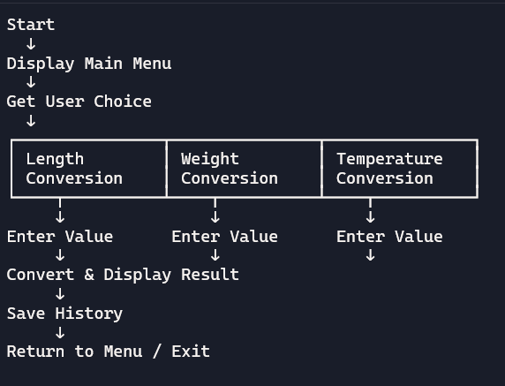
System Design
C Programming Project Presentation
Structure and workflow of the system
Start → Select Unit Category → Enter Value → Choose Conversion → Show Result → Option to Save
• Flowchart (logic flow)

Slide 7
Module Description
Input Module: Accepts user input for value and unit type
Conversion Module: Performs calculations using conversion formulas
Output Module: Displays converted result and optional explanation
File Handling Module: Saves conversion history and retrieves past logs
C Programming Project Presentation
Input Module: Accepts user input for value and unit type
Conversion Module: Performs calculations using conversion formulas
Output Module: Displays converted result and optional explanation
File Handling Module: Saves conversion history and retrieves past logs

Slide 8
Algorithm / Flowchart
C Programming Project Presentation
1. Start
2. Initialize variables
3. Input data from the user
4. Process data
5. Display output
6. Stop

Slide 9
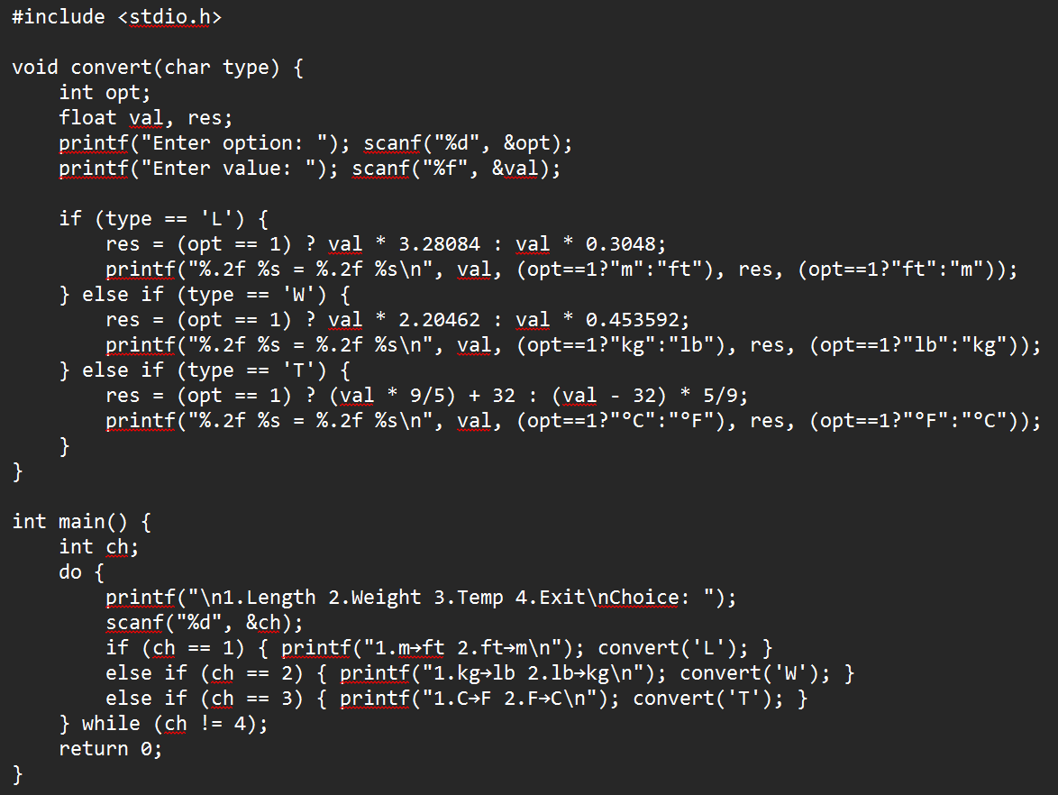
Source code
C Programming Project Presentation

Slide 10
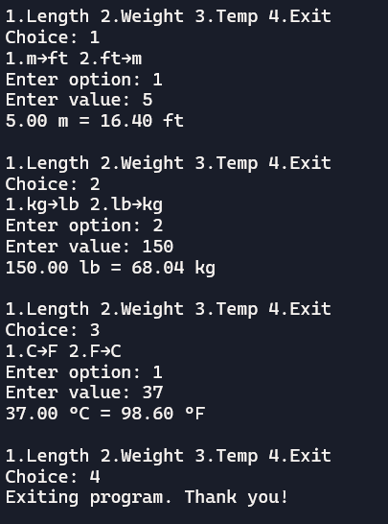
Output Screens
C Programming Project Presentation

Slide 11
Results & Discussion
C Programming Project Presentation
Functionality Verified: All conversion modules (Length, Weight, Temperature) produced accurate results based on standard formulas.
Modular Design: Each unit type handled by separate functions, improving readability and maintainability.
File Handling Success: Conversion history stored reliably using fprintf and fopen, confirming correct use of file operations.
User Experience: Menu-driven interface was intuitive and responsive, allowing smooth navigation between options.
Testing Outcomes: Sample inputs matched expected outputs across multiple test cases, validating logic and precision.
Challenges Faced:
Managing floating-point precision for temperature and weight conversions.
Simplifying the interface while retaining flexibility.
Resolutions:
Used formatted output (%.2f) for clarity.
Refactored repetitive logic into a unified convert() function for brevity

Slide 12
Conclusion & Future Enhancement
C Programming Project Presentation
Conclusion:
• Project achieved intended objectives
• Improved understanding of C concepts and system design
Future Enhancements:
• Add GUI support
• Integrate with database
• Extend functionality for scalability

Slide 13
References / Acknowledgement
C Programming Project Presentation
References:
• Let Us C – Yashavant Kanetkar
• C Programming – E. Balagurusamy
• Online resources and documentation
Acknowledgement:
• Express gratitude to mentor, department, and team members

Slide 14
Thank You
Closing Remark / Project Motto: "Convert smart, compute fast — one unit at a time!"
Questions & Discussions: We welcome your feedback and are happy to answer any questions about our Unit Converter Suite.

